Slide 1

Source

Slide 2



Welcome to Week 5
Lecture 2!
Data Science in Python &
Machine Learning

Slide 3
Assignments Due This Week by
Sunday night
Abalone Preprocessing Exercise (Core)
Pipelines Activity (Core)
Project 1 - Part 5 (Core)

Slide 4
Learning Goals:
Explain the three main types of variables we will be working with in this stack.
Convert data types into the correct format for machine learning
Implement data preparation in Python

Slide 5
Warm Up
What are the 3 primary kinds of variable features we learned about in the last stack.

Slide 6
Data Preprocessing
It must all be numbers.

Slide 7
Data Preparation
Interval/Continuous/Quantitative variables: Numbers that really mean numbers (int or float)
Examples:
Values of length in cm: [2, 3.5, 8]
Income in dollars: [57000, 38000]
Solution: No further preparation needed!
Note: Sometimes numeric data is in string form, such as ‘2’. This should be dealt with in data cleaning.

Slide 8
Data Preparation
Ordinal Categorical Variables: categories that can be ranked
Examples:
low/medium/high,
strongly disagree/disagree/agree/strongly agree
$5-10, $11-15, $16-20, >$20
Solution: Convert to numbers representing the rank (sometimes your best judgment is required):
Example:
df[ordinal_column].replace({‘low’:0, ‘medium’:1, ‘high’:2}, inplace=True)

Slide 9
Data Preparation
Categorical Nominal variables: different groups with no order.
NOTE: Sometimes these are represented as integers in the data, but should be interpreted as categories.
Examples:
Yes/No,
Male/Female/Nonbinary,
Fat free/Regular
Teacher A, Teacher B, Teacher C, Teacher D,
Solution: One-hot encoding

Slide 10
One hot encode
Each category becomes its own column
Genre
Drama
Comedy
Drama
Documentary
SciFi
Comedy | Drama | Documentary | Scifi
0 | 1 | 0 | 0
1 | 0 | 0 | 0
0 | 1 | 0 | 0
0 | 0 | 1 | 0
0 | 0 | 0 | 1

Slide 11

One-Hot Encoding Can Cause Data Leakage
How can data from the test set leak into the training set with one-hot encoding?
Consider this:
What if when you split the data there are categories in a nominal column that are present in the test set, but not the training set?
If you encoded the column before splitting, there would be a column assigned to that category, even though it’s not present in the training data!!
That’s data leakage.
So, we encode after splitting.

Slide 12
Transforming Data in Python:
SimpleImputer (imputes missing data)
Imputes missing values in many columns at once:
‘mean’, ‘median’, or ‘mode’ for numeric values
‘most frequent’, or constant for numeric and categorical values
Can be used on a subset of rows

Slide 13
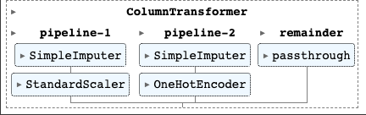
Make Column Transformer
Make Column Transformer allows you to process numerical and categorical columns with the appropriate strategy. Can allow you to process different columns differently.

Slide 14
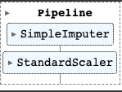
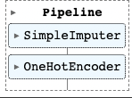
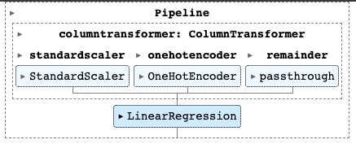
Pipelines
Pipelines allow you to chain together steps after a train test split that would normally require several lines of code without it.

Slide 15
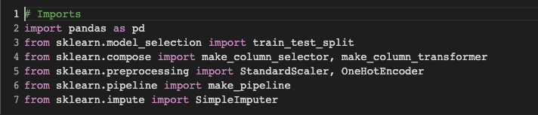
Import Libraries

Slide 16
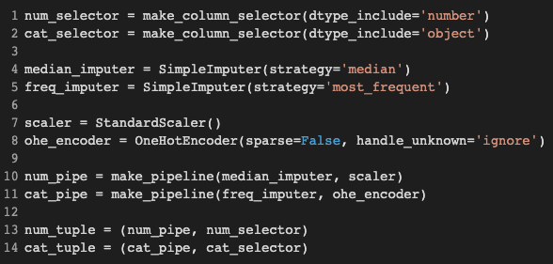
Pipelines and Tuples

Slide 17
Column Transformer
make_column_transformer(cat_tuple, remainder=’passthrough’)
By default ColumnTransformer DROPS any columns not specified in the steps.

Slide 18
Now you know what you need to know to prepare a dataset for modeling!
CodeAlong Notebook
CodeAlong DataSet

Slide 19
Challenge!
Tonight’s Challenge Notebook
Tonight’s Challenge Dataset

